Slide 1

BOB – Beta Demo
Team 08
Carson Wittwer, MH Charles-Etuk,
Jason Nelson

Slide 2
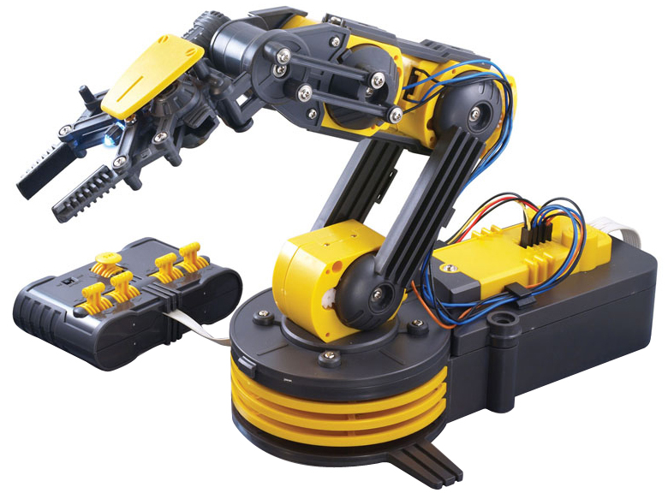
Arm Layout
Wrist
Elbow
LED
Arm
Fingers
Shoulder

Slide 3
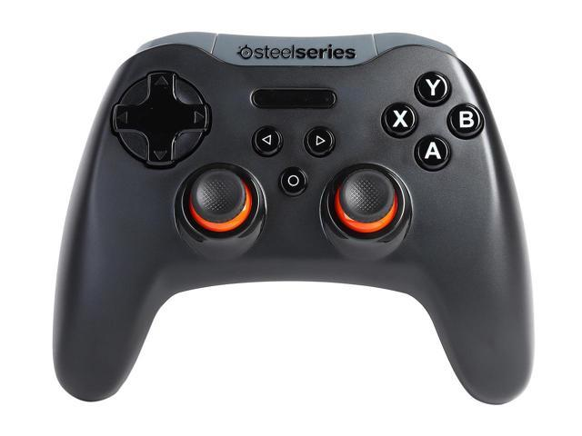
Controller Layout: Arm Control
DPAD:
(X-Axis) Fingers
(Y-Axis) Wrist
A Button:
Toggle LED
Left Thumbstick:
(X-Axis) Shoulder
(Y-Axis) Arm
Right Thumbstick:
(Y-Axis) Elbow
Home Button:
Toggle Control of Arm/Tracks

Slide 4
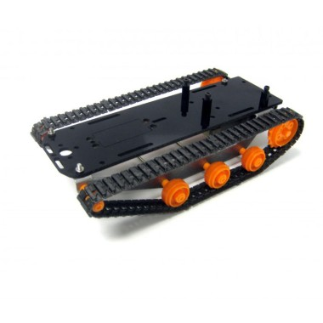
Controller Layout: Track Controls
Interesting Note:
A DC motor spins either direction, depending on current
An H-Bridge circuit will switch the switch the current depending on an input(GPIO from RasPi)
Left Thumbstick:
(X-Axis) Turning
Right Thumbstick:
(Y-Axis) Forward/Reverse
Home Button:
Toggle Control of Arm/Tracks

Slide 5
Controller Input to RasPi via Bluetooth
No API support for this controller on Linux base systems
Use EVDEV, an API that translates generic input from /dev/input
Must start by reading input and understanding how it is read in:
DEMO
Then using that, we can map input events to functions to use them
DEMO

Slide 6

To Be Finalized:
Controller
Socket connections
Arm
Get delivery of some parts
Build logic circuit to drive motors
Socket connection
Chassis
Wire logic circuit to drive motors
Socket connections

Slide 7



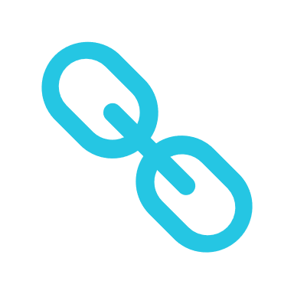
Thank You
+1 23 987 6554
april@www.proseware.com
www.proseware.com

